Slide 1


Shark Tank India: Investment Analysis
This presentation analyzes investment trends from Shark Tank India. It identifies successful industries, founder attributes, and funding patterns. Insights are provided for startups and investors to refine strategies.

Slide 2

Data Sources and Approach
Data Source
Approach
Shark Tank India dataset with startup details, investment amounts, and investor names.
Data cleaning (duplicates, missing values)
Data transformation (categorized industries)
DAX for calculated measures

Slide 3

Data Preprocessing
1
Standardized Conventions
2
Irrelevant Columns Removed
Ensured naming consistency across the dataset.
'Episode Number' and 'Company Website' were excluded.
3
Data Types Modified
Dates formatted, text fields cleaned for consistency.

Slide 4

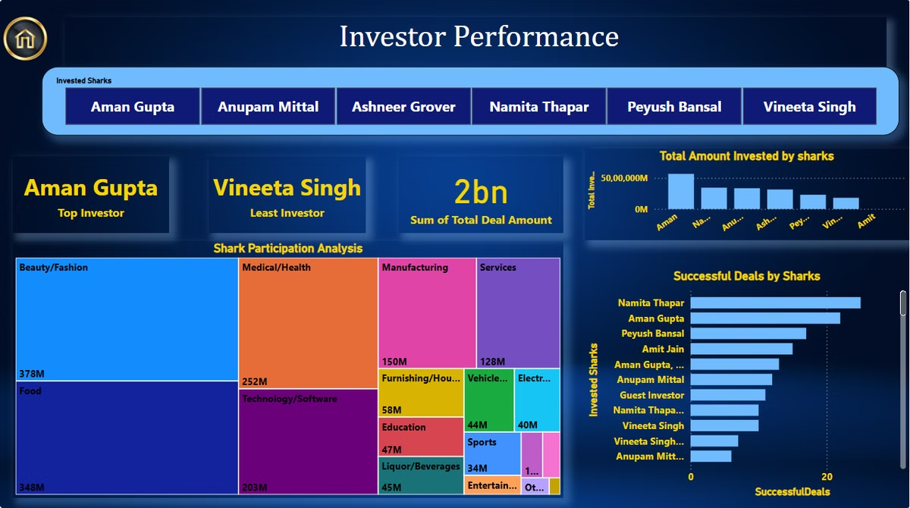



Key Business Insights
Top Investors
Top Industries
Investor Preferences
Aman Gupta invested ₹69.1 crore across all seasons.
Identified sectors with high funding and growth potential.
Analyzed investment choices across different sharks.

Slide 5

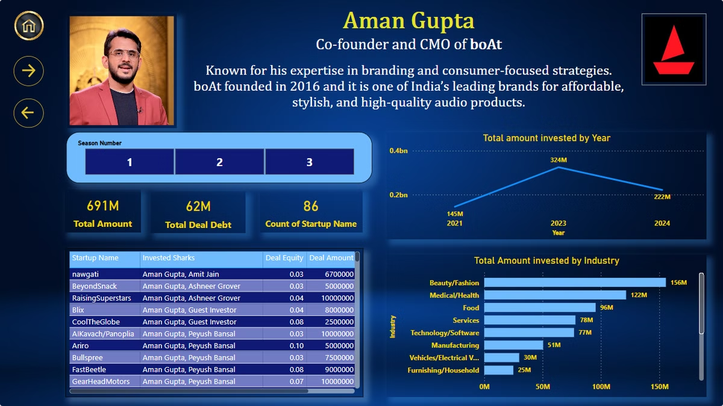



Dashboard Visualizations
Bar Charts
Funded industries and investor contributions displayed.
Pie Charts
Distribution of deal types and investment proportions.
Trend Analysis
Year-wise investment trends to identify growth patterns.

Slide 6

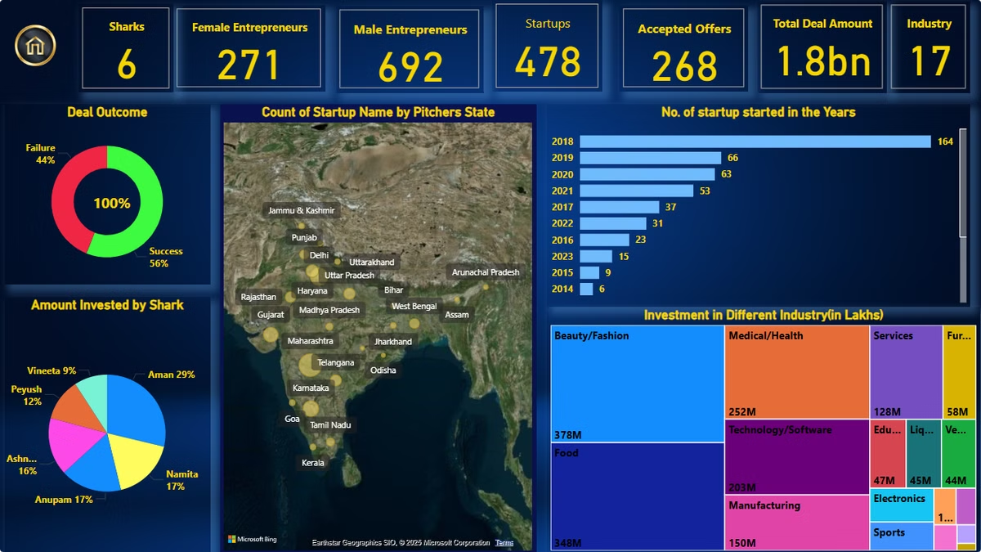
Dashboard Insights
Investor Contributions
Startup Performance
Breakdown of total investments per shark.
Funding received by companies and their market impact.
Geographical Trends
Mapping investments by location to uncover funding hotspots.

Slide 7

Future Dashboard Enhancements
1
Live Data Integration
Enable real-time updates with live investment data.
2
Predictive Analysis
Forecast startup investment likelihood using AI/ML.
3
Comparative Insights
Compare Shark Tank India to global counterparts.

Slide 8

Key Takeaways
Investment patterns indicate promising sectors and investor preferences.
Startups should focus on high-investment sectors for better funding.
Investors can diversify portfolios based on emerging trends.
Further dashboard enhancements will offer deeper insights.

